Slide 1


Bus ticket booking system
Streamline your travel with our cutting-edge Bus Ticket Booking System - book, manage, and enjoy your journey effortlessly!
Team Members(Group 20)
Nitin Singh Sikarwar
Prathamesh Kokitkar
Ritesh Kumar Verma Sumukha HR Yogesh Sharma
Date: 05/18/2023

Slide 2

Agenda
1. Problem Statement
2. Introduction
3. Objective
4. Tech Stack
5. Demo
6. Challenges and Learnings
7. Future Scope
8. Conclusion

Slide 3
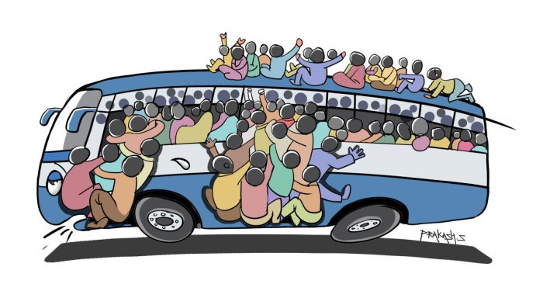

Problem Statement
In the existing system lacks a streamlined process for booking tickets, selecting routes, and managing user profiles, while administrators face challenges in manually managing routes, tickets, and buses. This results in operational complexities, limited insights for decision-making, and a need for process optimization.

Slide 4

Introduction
This project aims to provide a convenient and efficient platform for users to book and manage bus tickets. The system includes separate login pages for administrators and users. Users can book and manage their tickets, as well as update their profile details. They can also select routes and book tickets accordingly.
Administrators have additional privileges, allowing them to perform CRUD (Create, Read, Update, Delete) operations on routes, manage tickets and buses, and access a dashboard that provides key information such as buses, no of tickets, no of routes.

Slide 5

Objective
Empower users to book and manage their tickets and profile information, as well as select and reserve routes. Provide admin capabilities for managing routes, tickets, and buses, along with a dynamic dashboard displaying key metrics such as buses, no of tickets, no of routes.
Additionally, include an informative "About Us" section showcasing project details and developer information.

Slide 6


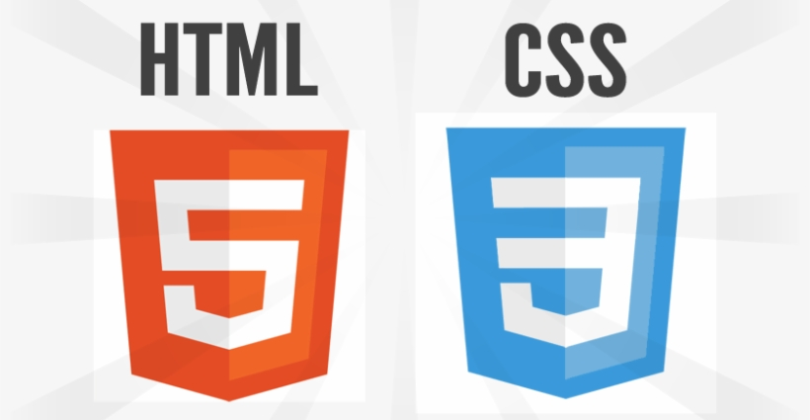


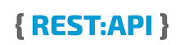

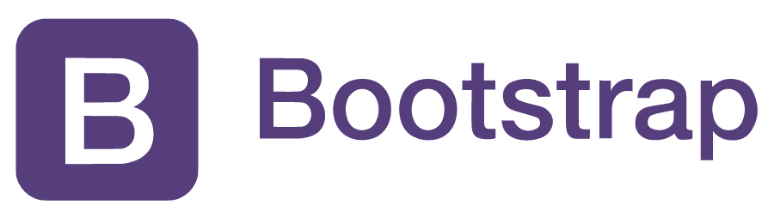




Tech stack
Frontend
Backend
Angular Framework
Typescript
HTML & CSS
Bootstrap
OpenLayer
Razorpay
SpringBoot
Spring Maven
Spring JPA
Restful APIs
MySQL
SQL Workbench

Slide 7
References
W3 Schools
Stack Overflow
GeeksForGeeks
Google.com
Github
Webcode.tools

Slide 8
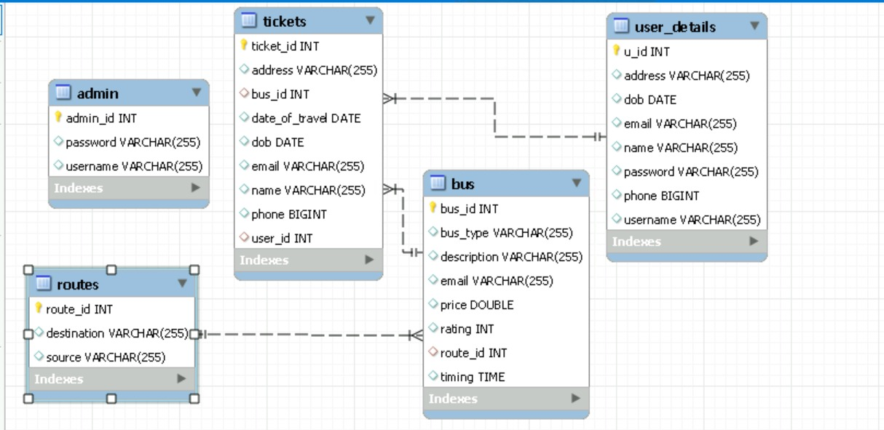
E-R Diagram

Slide 9
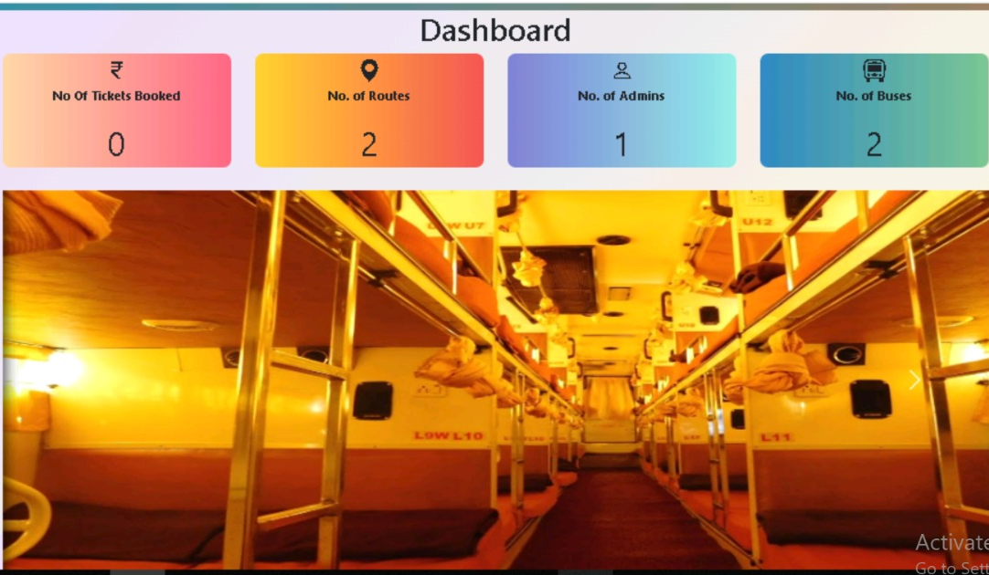
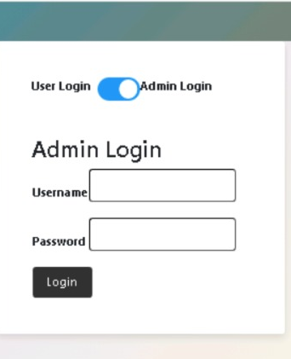
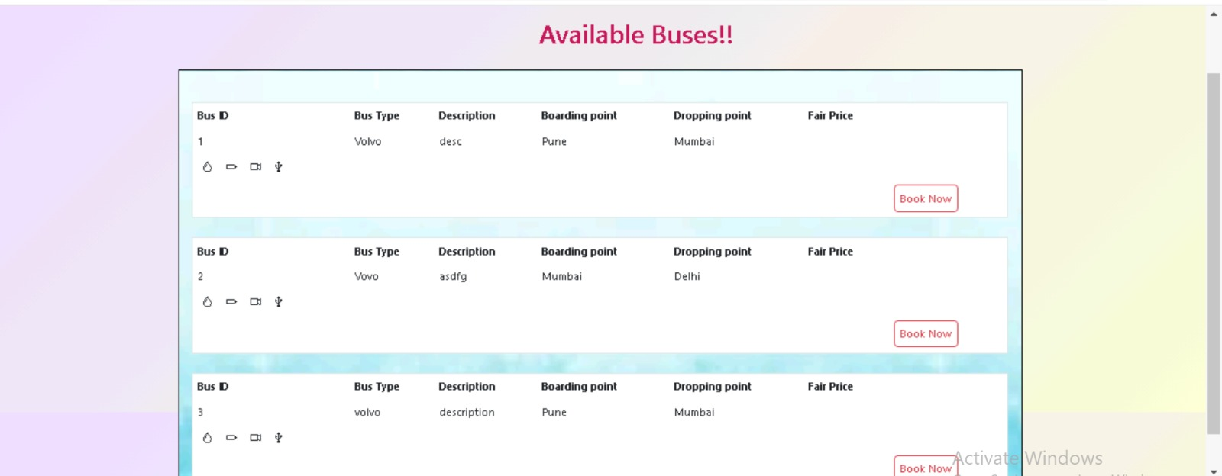
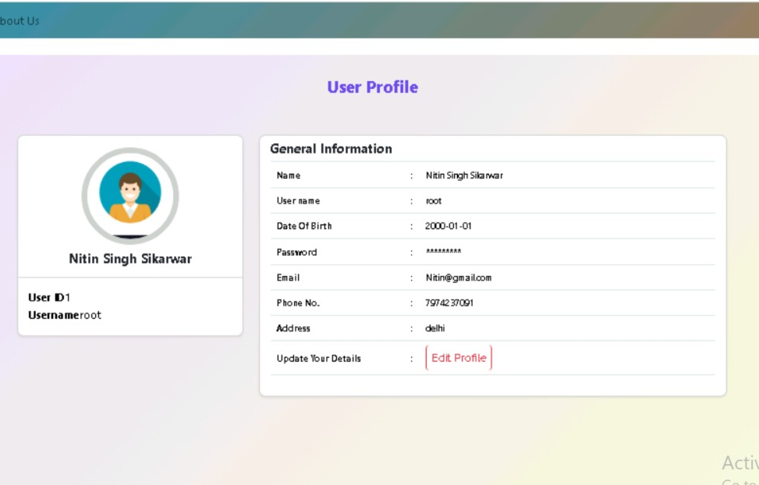
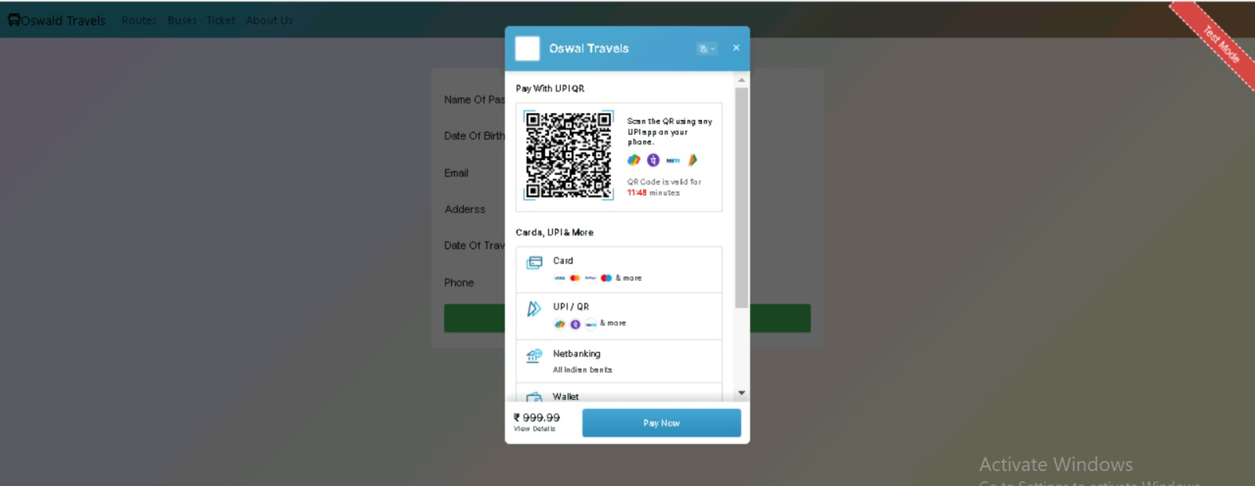
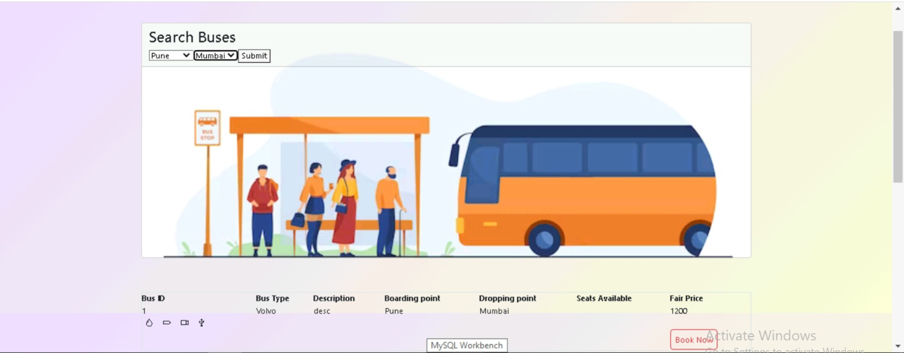
Demo

Slide 10
Challenges & Learnings
Challenges
Learnings
Integrating multiple technologies:
Coordinating Java, Spring Boot, Angular, MySQL, TypeScript, and Bootstrap.
Payment integration:
Implementing secure payment system, integrating payment gateway, handling APIs and protocols.
Designing intuitive user interface:
User-friendly interface for ticket booking, profile management, route selection with focus on usability and responsiveness.
Full-stack development:
Java, Spring Boot, Angular, JPA Repository, and MySQL - handling both backend and frontend.
Integrating technologies:
Managing dependencies, ensuring seamless communication between components.
Database management:
CRUD operations, query optimization.
.

Slide 11

Future scope
Real-time bus tracking: Implement a real-time bus tracking feature that allows users to track the location and estimated arrival time of their booked buses. This enhances the user experience and provides them with accurate information about their journey.
Integration with travel agencies: Explore partnerships with travel agencies to expand the reach of the bus ticket booking system. This collaboration can help increase the availability of routes, buses, and attract a larger user base.
AI-powered chatbot: Integrate an AI-powered chatbot into the website to provide instant customer support and assistance. The chatbot can handle common queries, provide booking recommendations, and assist with any issues or inquiries users may have, improving customer satisfaction.

Slide 12

Conclusion
A comprehensive Bus Ticket Booking System website with user and admin login, ticket and route management, payment processing, and informative sections, developed using Java, Spring Boot, Angular, JPA Repository, MySQL, TypeScript, and Bootstrap.

Slide 13
THANK YOU
Mentors:
Sailatha Kasanagottu
Navya Kolipaka
Prasunamba

